Slide 1
Inbound and Outbound.

Slide 2
Prepared By
Project developed by | T-Code
M Selvaraj | PL0122159
S Santhosh | PL0122173
M Monisha | PL0122160
R Kabilan | MT2021435
B Lavanya | MT2021439
Catherine | MT2021433
N Sowmiya

Slide 3
Table Of Contents: 1. Introduction 2. Purpose of Textile inbound & outbound 3. Design and Detail techniques 4. Other Technical Changes 5. Additional details 6. Advantages/ Drawbacks

Slide 4
Introduction
Definition: Inbound logistics is the receiving of raw materials or products from a supplier to a warehouse and parallelly Outbound logistics are the actions required to get the final goods delivered to the end user. Outbound process- the process of making calls to the customer. Inbound customer - The process of receiving calls from the customers
Under this paradigm, Inbound logistics brings supplies or materials into a business, while outbound logistics deals with moving goods and products out to customers. Both focus heavily on the transporting of goods. Now all the raw materials that are incoming to the plant for further processing are inbound activities. In this phase, transport for steel, rubber, plastics, glass and other things to the factory is still required.

Slide 5
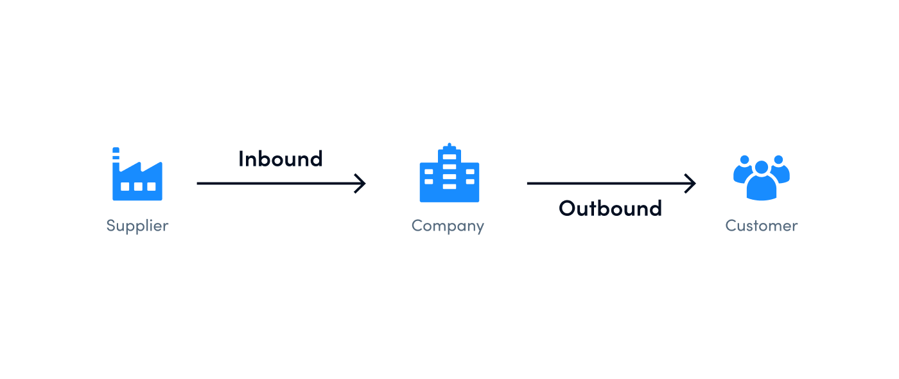
Purpose of Inbound & Outbound.

Slide 6
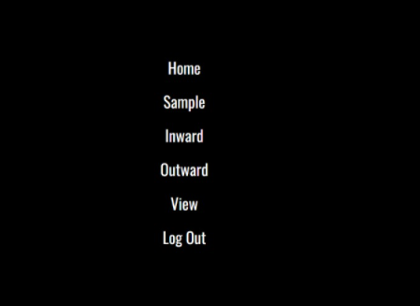
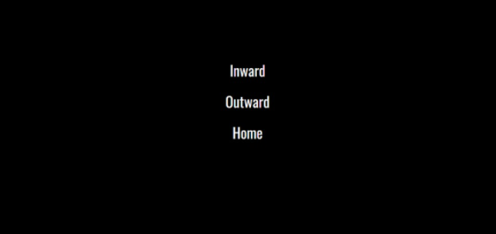
Model look of our project.

Slide 7
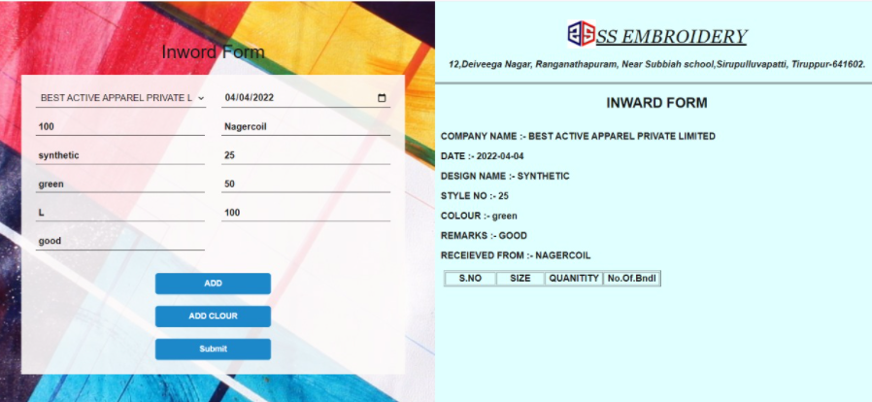
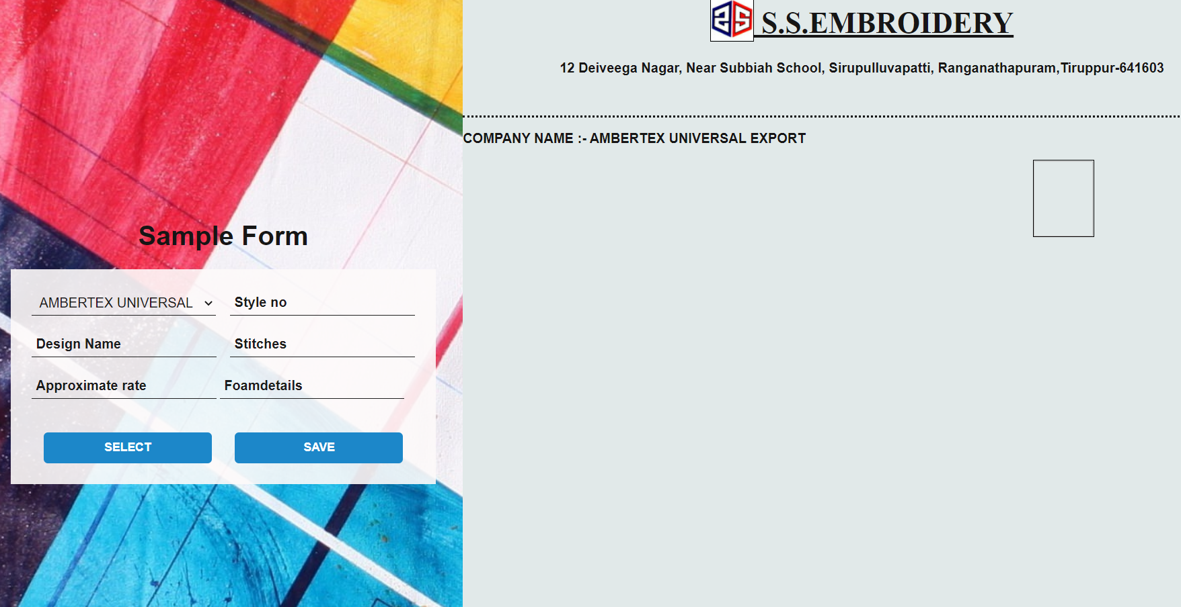
Inword form Model Look of our project.

Slide 8
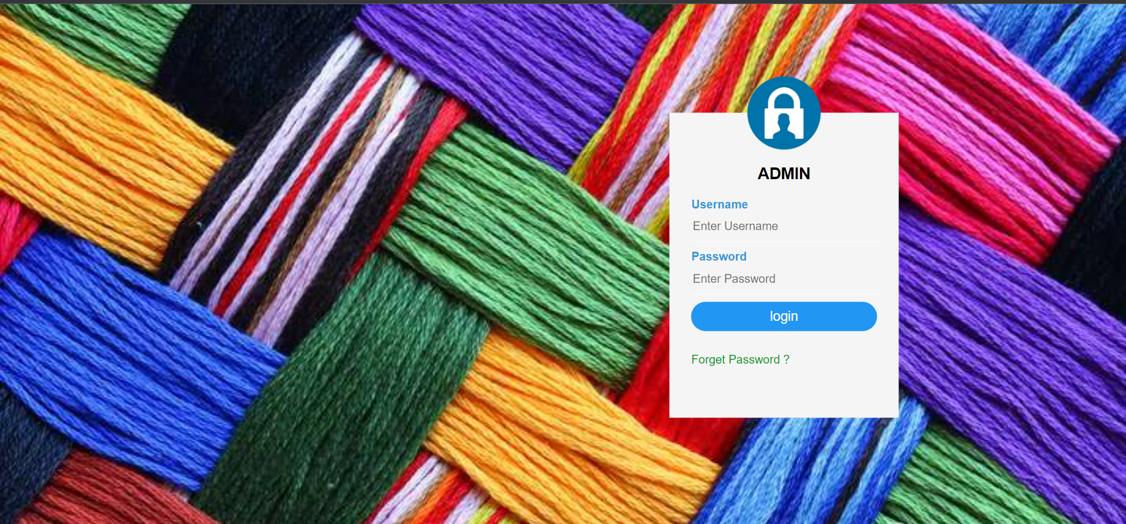
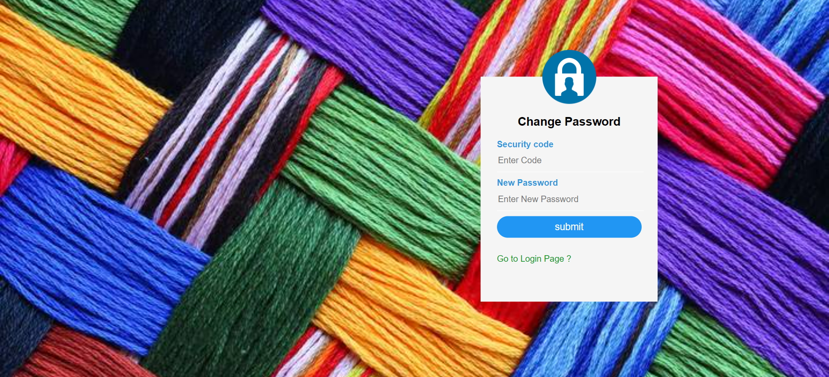
Login page.

Slide 9
Presentation Layer:
This layer consists of all UI components.
Export component: The plug-in is used to export the reports in pdf format. It helps to reduce the workload on the web/ application server.
Validation component: All basic level data validations should be done at UI level.
Report component: All reports to be generated to the user, will be processed and generated at the browser end.
Resources: All HTML/CSS/ images, which are required for the page design.

Slide 10
Application Layer:
This layer comprises of all server and business classes.
Configuration settings (XML or Class based) will define the application and server configuration.
Spring Controllers defines the server classes, which are required to process the incoming http requests.
Service classes are required to perform the required business services.
REST Controllers to process the HTTP requests.
Model classes are used the define the functions of the entities present in the system.

Slide 11
Inbound Logistics Activities
Sourcing and procurement:
Identifying and evaluating potential suppliers, obtaining price quotes, negotiating with and managing suppliers.
Ordering/purchasing:
Buying the goods and materials the company needs so the right quantity arrives at the right time.
Transportation:
Deciding whether to use a truck, airplane, train or another method to move goods. This activity also involves selecting delivery speed for incoming supplies, contracting with third-party carriers and working with vendors on price and route.
Receiving:
Handling the arrival of new materials, unloading trucks and ensuring they match the order.

Slide 12
Material handling:
Moving the received goods short distances within the facility and staging them for later use.
Put away:
Moving goods from the receiving dock to storage. Staff puts everything away in assigned locations.
Storing and warehousing:
Managing the materials before they go to manufacturing or customer fulfillment. This department is responsible for making sure items are placed in logical locations for fulfillment and the right storage conditions are met.
Inventory management:
Deciding the type and number of raw materials/items you should store and where to locate them.

Slide 13
Expediting:
Managing the progress of and schedule for materials as they make their way to your facility.
Distribution:
Sending supplies to their destination inside the business.
Tracking:
Checking on details about incoming orders, such as their location and documents like receipts.
Reverse logistics:
Bringing goods back from customers for reasons such as returns, defects, delivery problems, repair and refurbishment. Also, recycling and salvage firms that work with used materials obtain their supply through reverse logistics.

Slide 14
Additional Details. Technology used in Textile Inbounds/Outbounds.
How is Technology used in textiles?
Technological advancements in the textile industry include the use of new machines. For example: Knitting machines - Machines create knitted fabrics in large swaths of material, instead of long strips, that are then looped and sewn together. Pleating - Pleating can now be done solely by machines instead of laborers.
What are textile technologies?
Textile Technology is a division of engineering where the principles of scientific techniques are utilized for manufacturing and development in all types of yarns and textile fabric from textile fibers.

Slide 15
Advantages:
Inbound and Outbound marketing is sustainable.
Costs Effective i.e., cheap in rate.
Online withdrawal applicable.
Increases visibility.
Customer beneficial.

Slide 16
Drawbacks:
Campaigns require a constant time investment to produce content that is of sufficient quality to be useful. The efficacy on an inbound campaign only becomes evident three months after the campaign is established, and results may be more difficult to measure.
Tracking return on investment can be difficult without the implementation of Web analytics to determine how effective an inbound campaign is.

Slide 17
Thank You!

